Slide 1

RUNGTA COLLEGE OF DENTAL SCIENCES AND RESEARCH
Endodontic instruments
DEPARTMENT OF CONSERVATIVE DENTISTRY AND ENDODONTICS

Slide 2
Specific learning Objectives
At the end of this presentation the learner is expected to know ;
Core areas* | Domain ** | Category #
Instruments for surgical endodontics | Cognitive | Nice to know
Lasers in endodontics | Cognitive | Nice to know

Slide 3
Content
Standardization of Instruments given by Ingle and Levine
Classification of Endodontic Instruments
Group I Hand-operated Instruments
Files
Group II Low Speed Instruments with Latch-Type Design
Group III Engine-Driven Instruments
Generations of NiTi Rotary Files
First Generation NiTi Rotary Files
Second Generation
Third Generation Files
Fourth Generation Reciprocating Instruments
Fifth Generation Instruments
Scout Race Files
Group IV Sonics and Ultrasonics in Endodontics
Sonic Handpiece
Instrument Deformation and Breakage
Instruments Used for Filling Root Canals

Slide 4
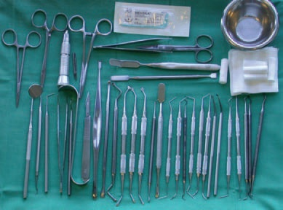
INSTRUMENTS FOR SURGICAL ENDODONTICS

Slide 5
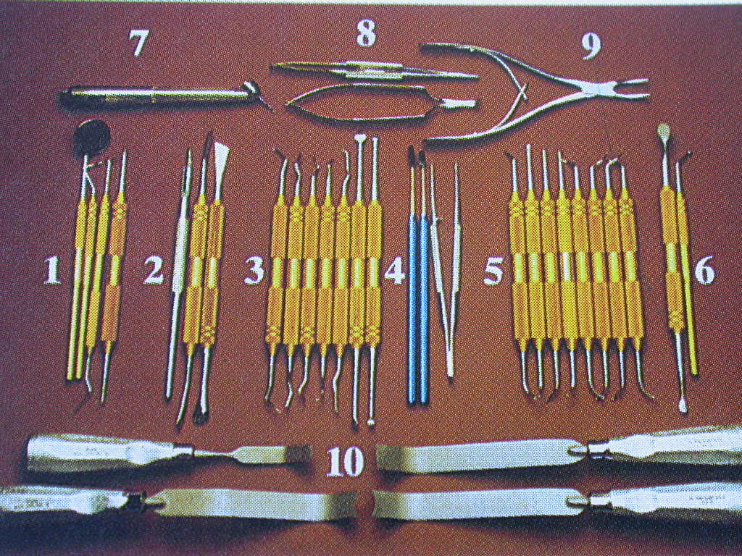
Endodontic microsurgical instrument set up used in the department of endodontics at university of pensylvania school of dental medicine:
1) Examination Instrument
2) Incision And Elevation Instrument
3) Curretage Instrument
4) Inspection Instrument
5) Retrofilling Carriers And Plugging Instruments
6) Miscellaneus Instruments
7) Osteotomy Instruments
8) Suturing Instruments
9) Tissue Removal Instruments
10) Tissue Retraction Instruments

Slide 6
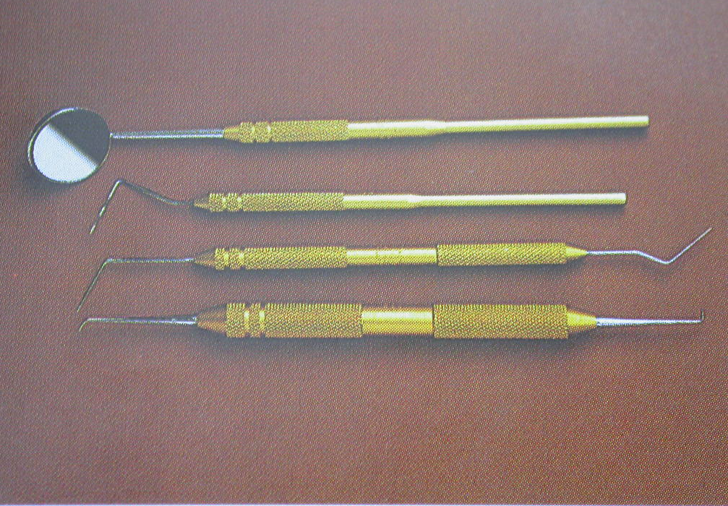
1) EXAMINATION INSTRUMENTS
Dental mirror
Periodontal probe
Endodontic explorer
Micro explorer

Slide 7
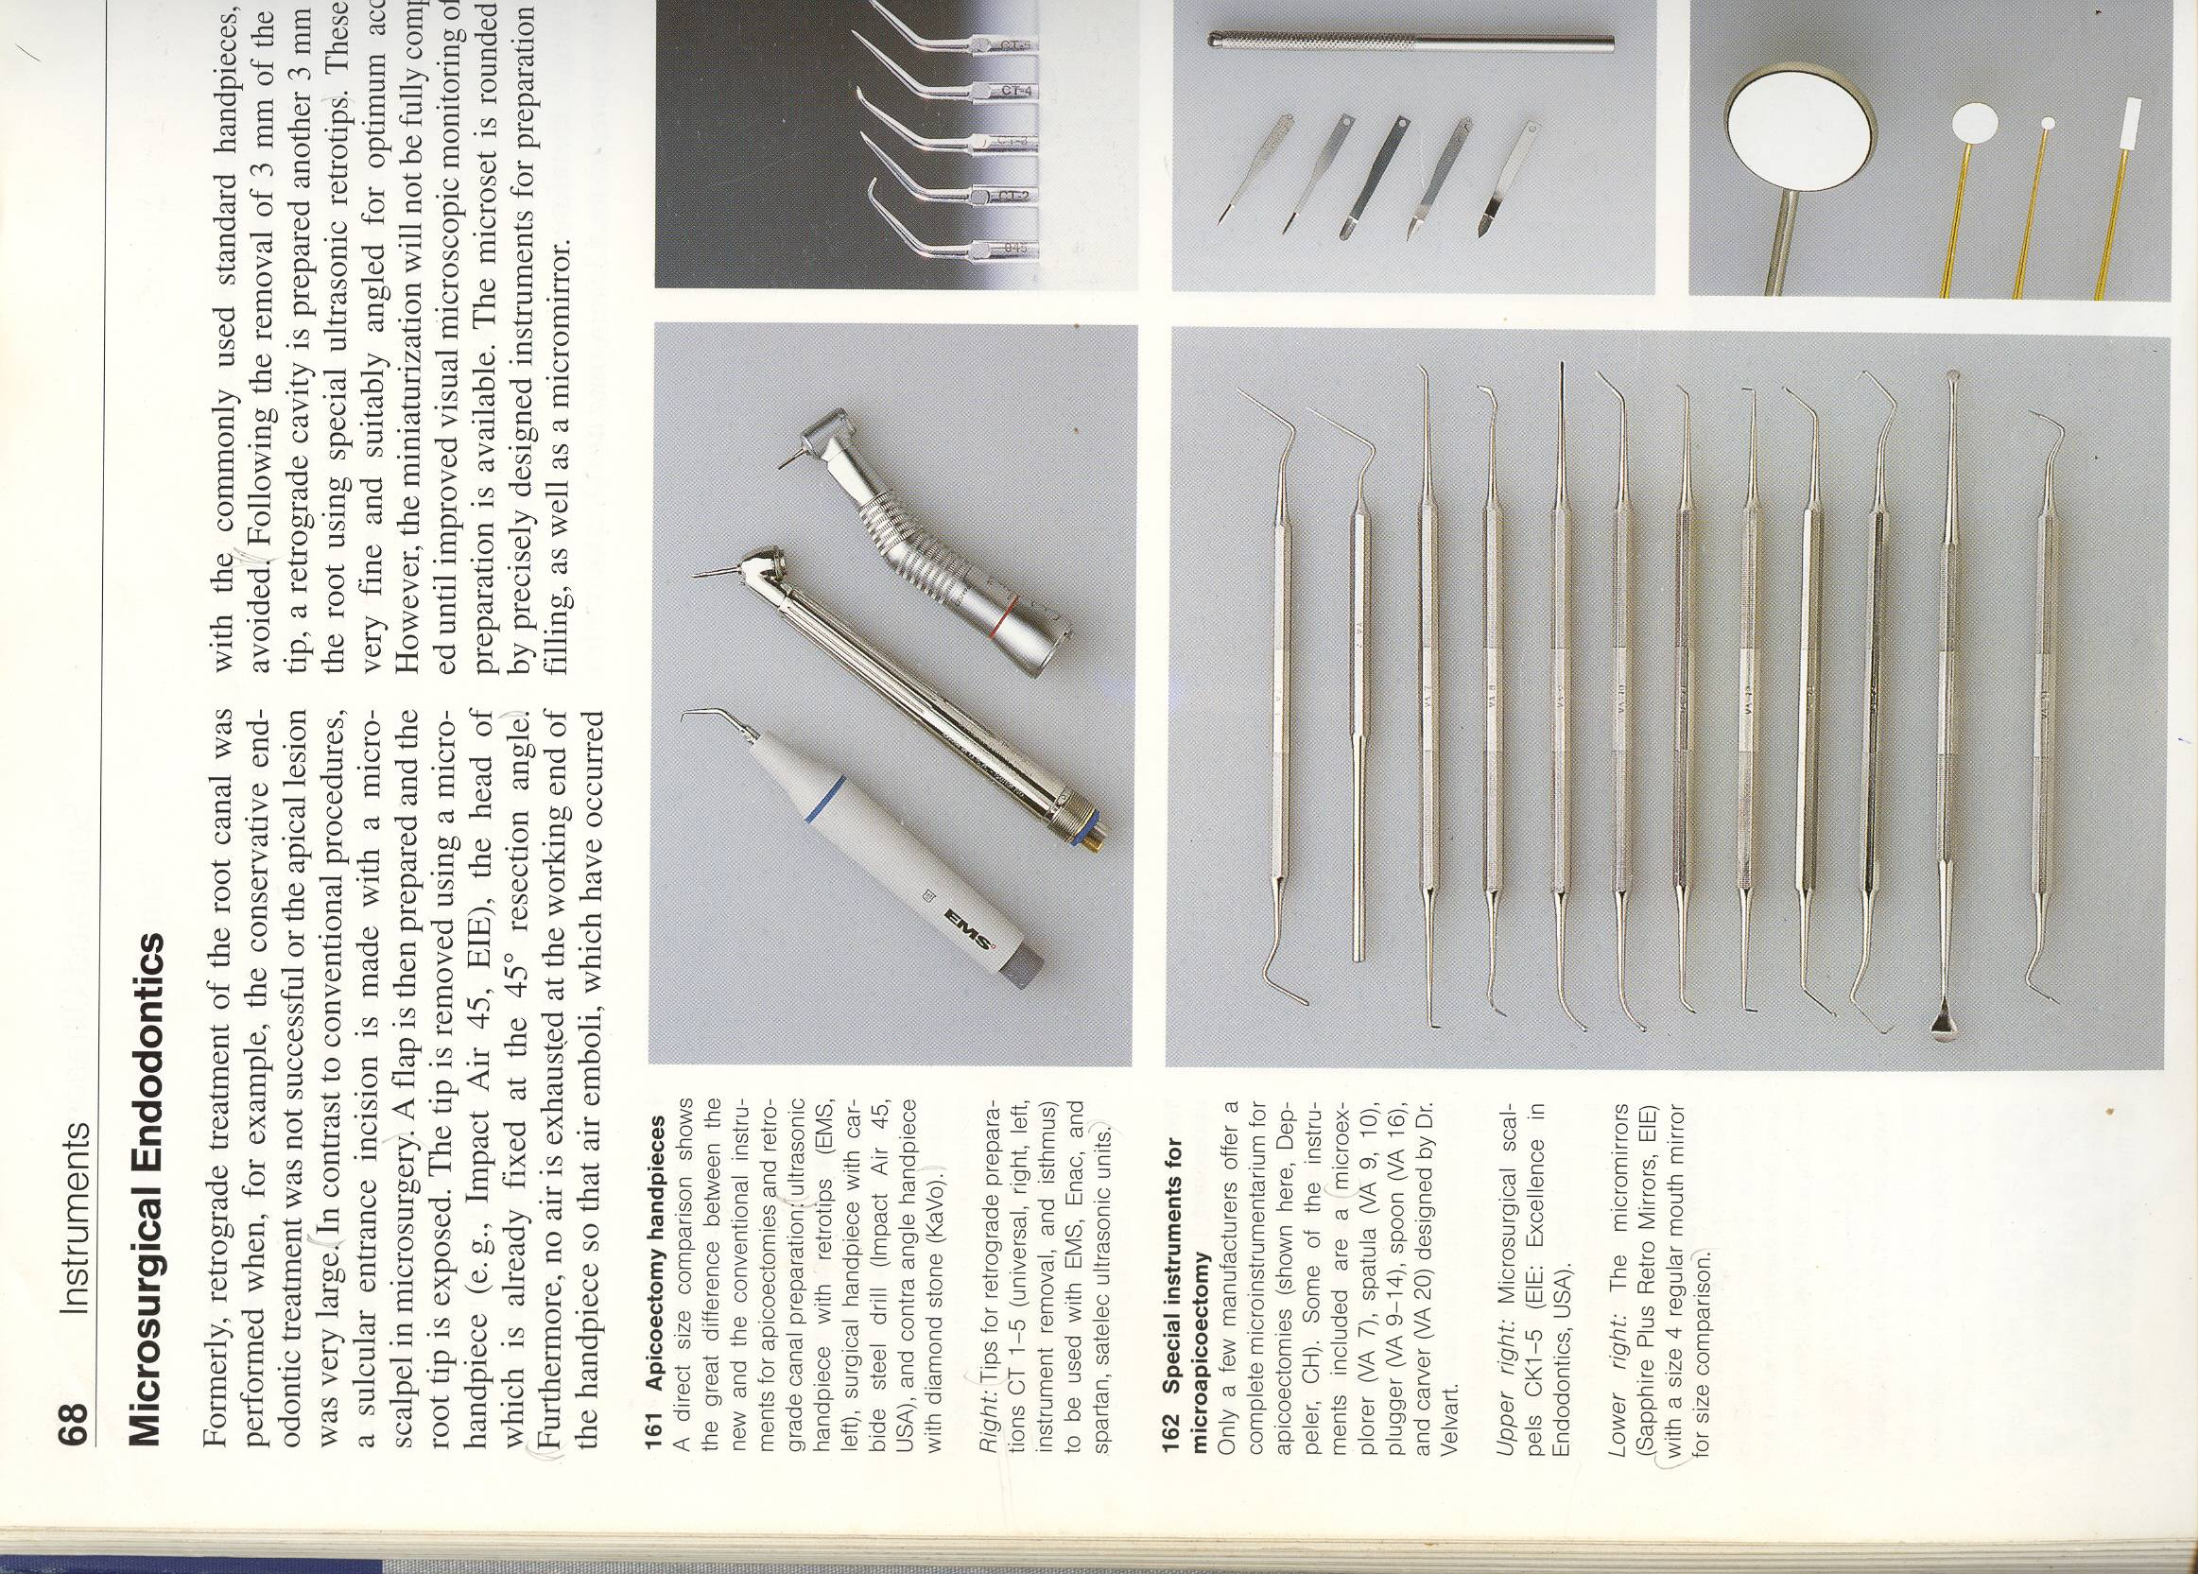
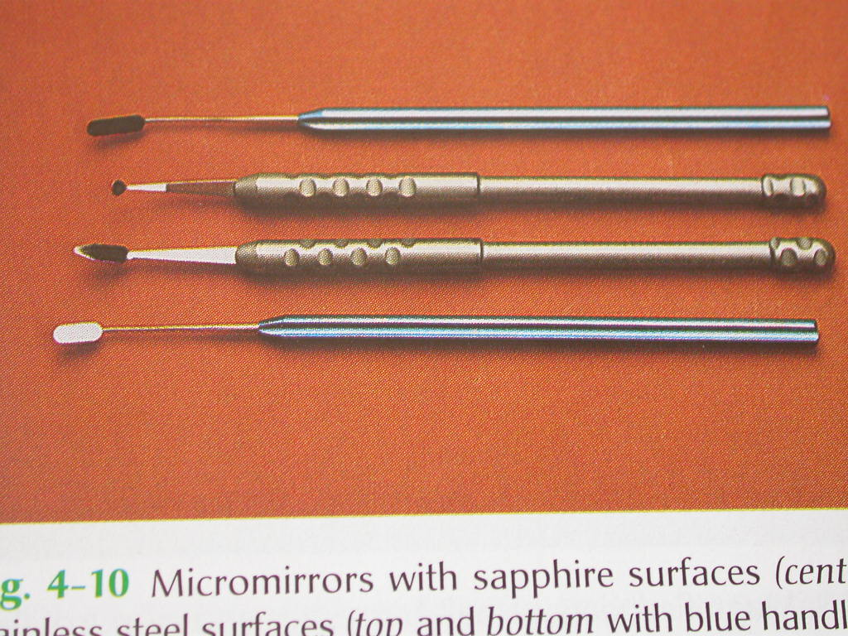
1) Inspection instruments:
Micromirrors:
Made of stainless steel .
Are available in different shapes but
The round and rectangular has proved to be most useful.
An important feature of the neck of micromirrors is flexibility.
This feature allows to view the resected root surface completely
Another type is made up of scratch –free saphire surfaces

Slide 8
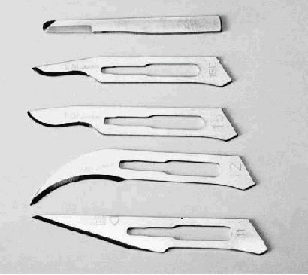
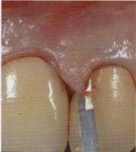
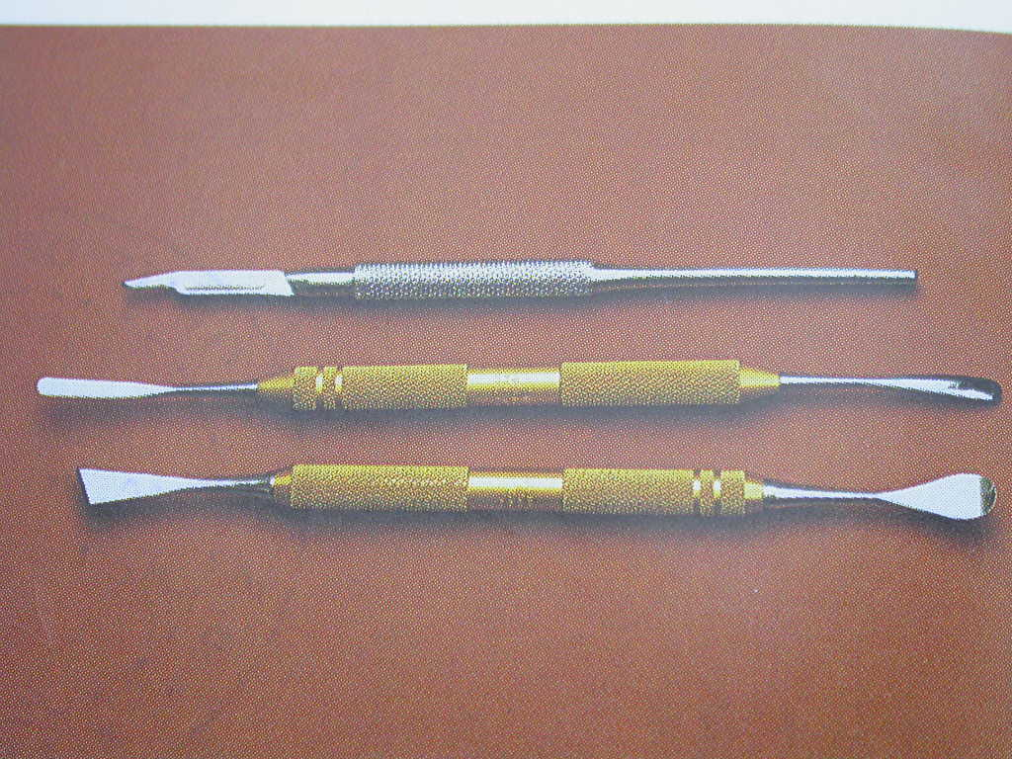
Bard Parker Blade
No. 15c
No. 15
No. 12
No. 11
2) INCISSION AND ELEVATION INSTRUMENT:
These include a 15c blade and handle and soft tissue or periosteal elevators
Micro blades are useful when the interproximal spaces are very tight
SOFT TISSUE ELEVATORS : One end has a thin sharp triangular beak and the other end has a sharp rounded beak that varies in size
This new design incorporates thin sharp edges and points that allow the soft tissue s to be elevated from the bone cleanly and completely

Slide 9
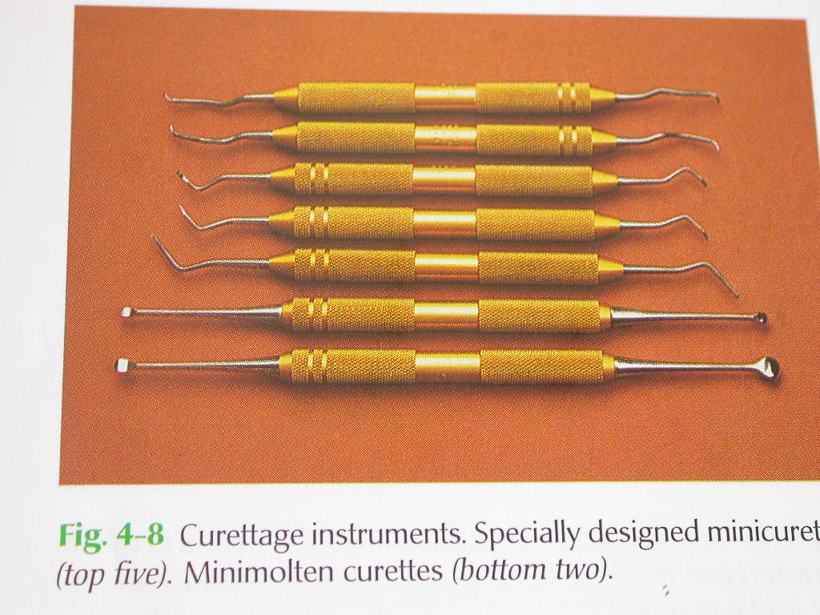
3) CURRETAGE INSTRUMENTS:
Includes a minijacquette 34/35 scaler,a columbia 13-14,and mini molten and miniendodontic curettes
Curretage of the lingual wall or periodontal ligament,which requires minaturised currete

Slide 10
5) RETROFILLING CARRIERS AND PLUGGING INSTRUMENTS:
Retrofilling carriers:each has a point 0.5mm diameter ball on one end and a 1mm wide blade on the other is offset at 45 degrees
The flat surface is designed to carry retrofilling material to the retropreparation and ball end is designed for packing materials into the preparation

Slide 11
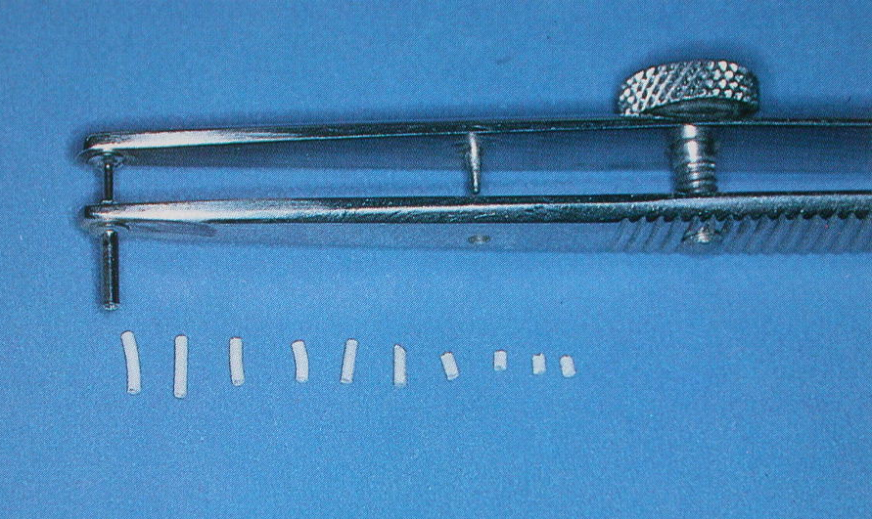
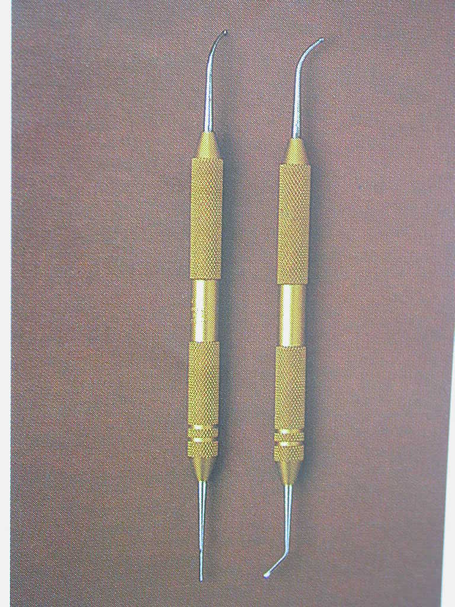
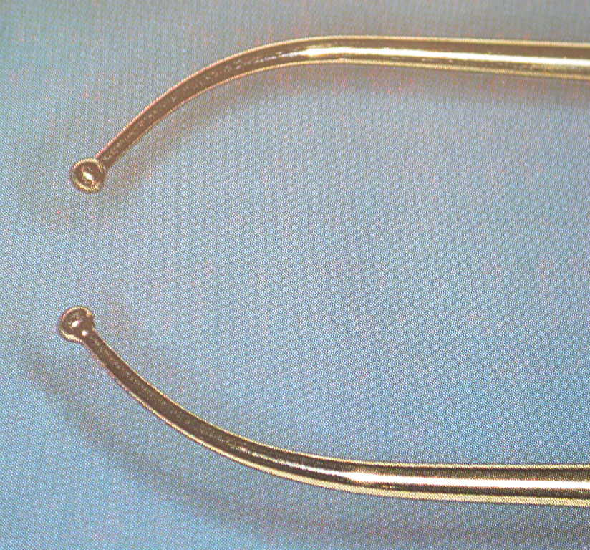
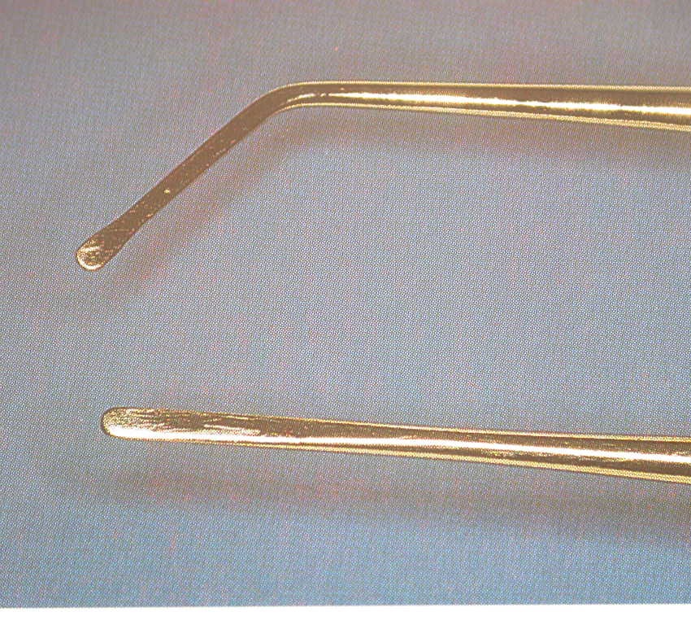
RETROFILL CARRIERS

Slide 12
MICRO PLUGGERS:
Has ball ends ranging from 0.2 to 0.5mm in diameter on one end .
Two of the instruments have a 90 degree and a 65 degree tip with a straight handle
Two angled micro plugger:tips are offset by 65 degrees
One left and one right for left and right molar surgery
All micro plugger tips are 3mm long and 0.2mm or 0.5mmin diameter

Slide 13
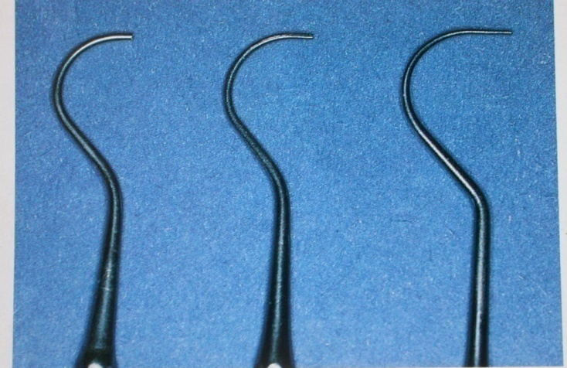
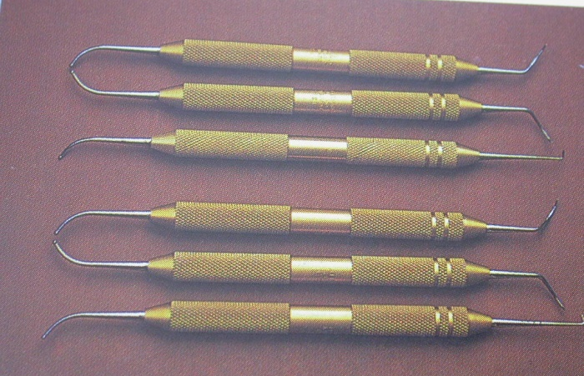
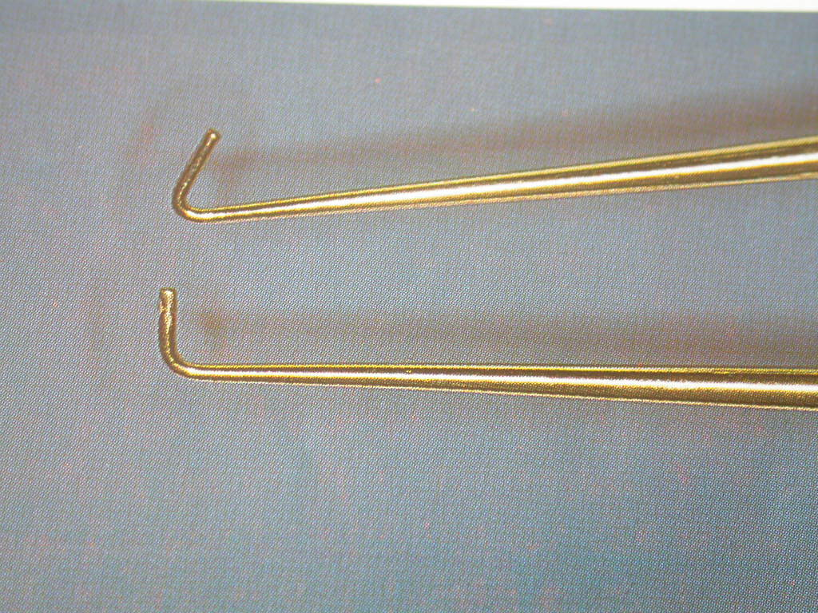
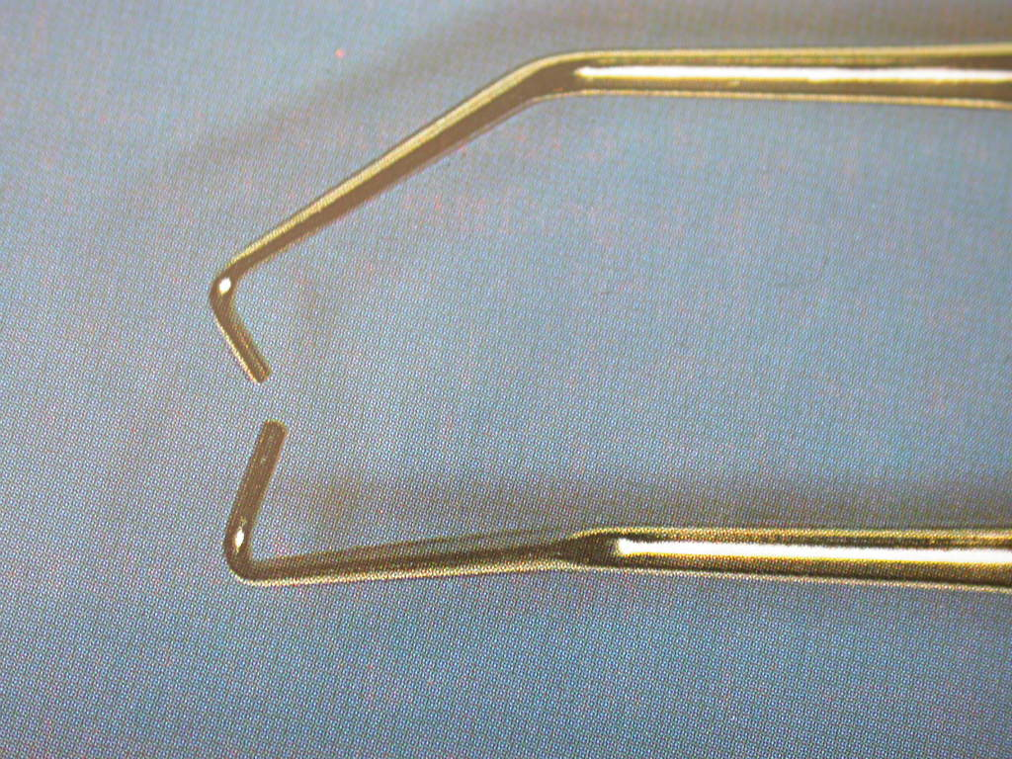
RETROFILL PLUGGERS

Slide 14
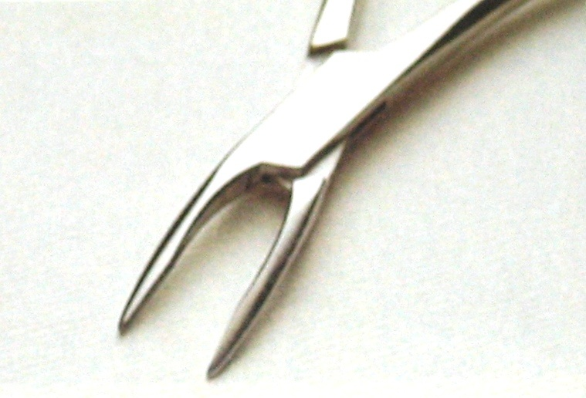
6) MICELLANEOUS INSTRUMENTS:
Large ball burnisher and bone files are used to smooth the bone and root surface,
Bone Augmenting Materials such as calcium sulfate to bone contours
Mini rongeur:
The beaks are minaturised to fit into hard to reach areas deep inside the bony crypt
It is used to remove granulation tissue from a lesion

Slide 15
7) OSTEOTOMY INSTRUMENTS:
The Impact Air 45 Handpiece :it has a 45 degree angled head makes it easier to work in difficult to reach areas.
It is designed to direct water onto the cutting surface of the bur while air is ejected through the back of the hand piece
This reduces the chances of emphysema and pyemia and creates less splatter than a conventional handpiece
H 161 Lindermann Bone Cutting Burs has fewer flutes than conventional burs resulting in less clogging and frictional heat and more efficient cutting

Slide 16
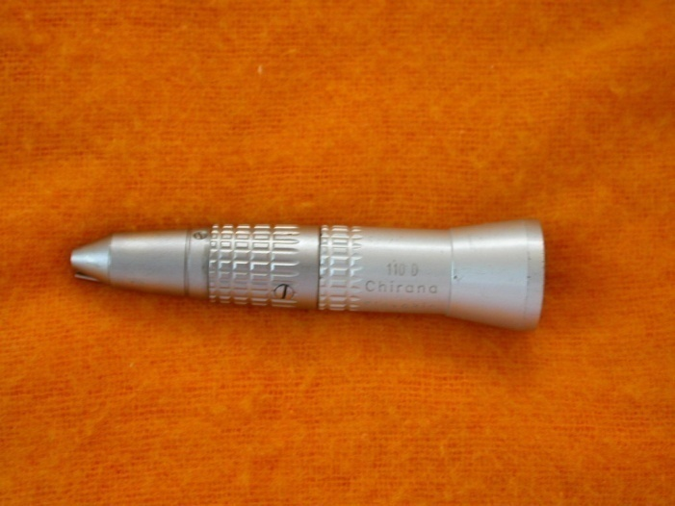
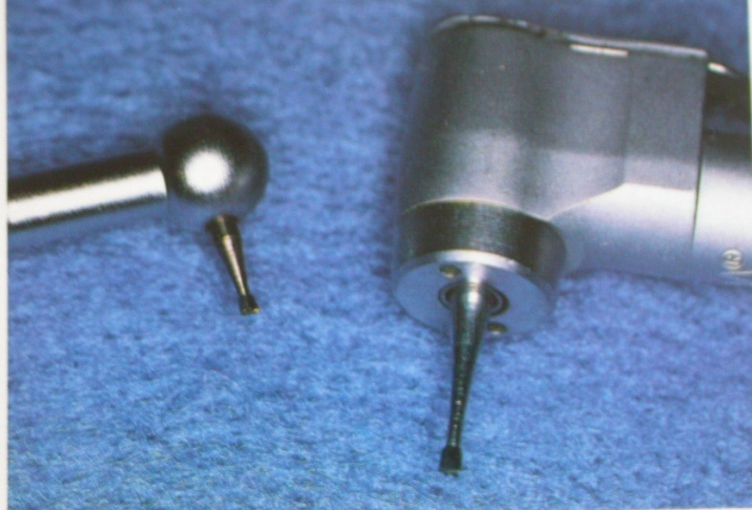
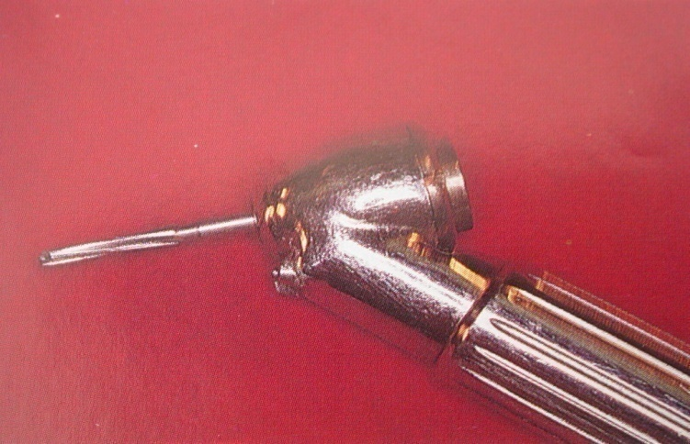
OSTEOTOMY INSTRUMENT
Straight Handpiece
Microhead Handpiece
Impact air 45º handpiece
H 161 Lindemann bur

Slide 17
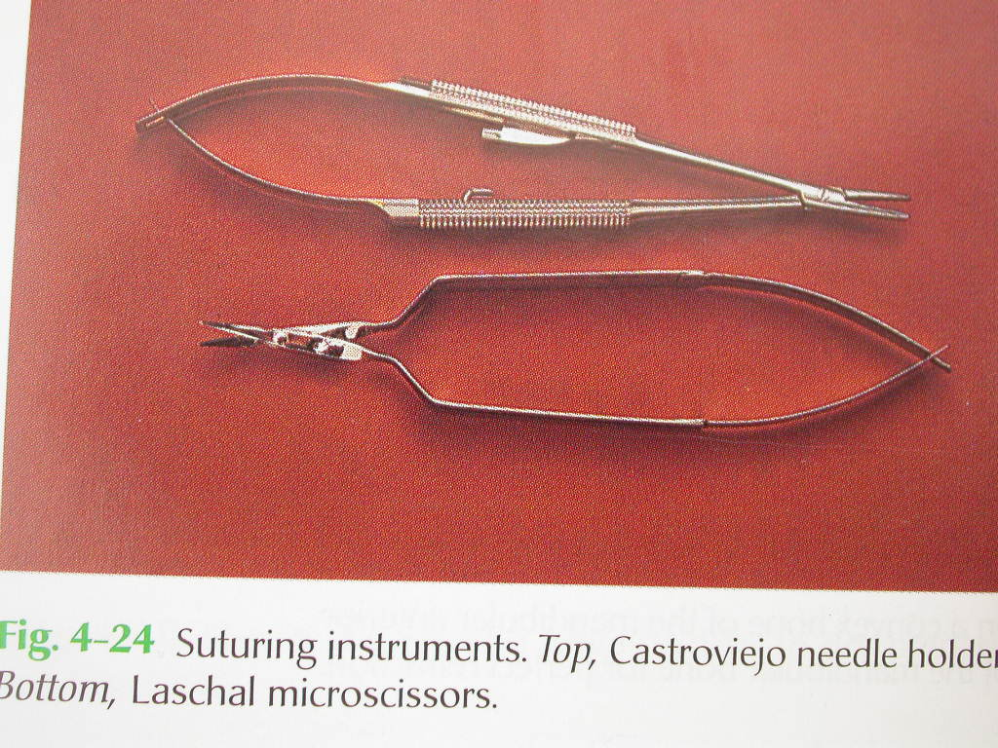
9) SUTURING INSTRUMENTS:
1) Castroviejo Needle Holder :
it is smaller in size
Useful in difficult and delicate suturing
Suture material:5-0,6-0 monofilament sutures of nylon or propylene are used
Suture needles: with triangular cross section for easy penetration of the tissue and ½ and 3/8 curvatures are recommended
2) Castroviejo Scissors :
Used to cut fine Suture Material

Slide 18
9) TISSUE RETRACTION INSTRUMENTS:
The Kim /Pecora(KP):1,2and 3 retractors :
Have wider mouths than conventional retractors(15mm compared to the 10mm)and are 0.5mm thinner
Their serrated ends anchor the retractor s securely onto the bone.
The KP retractors are modeled on concavities and convexities of the cortical bone plate

Slide 19
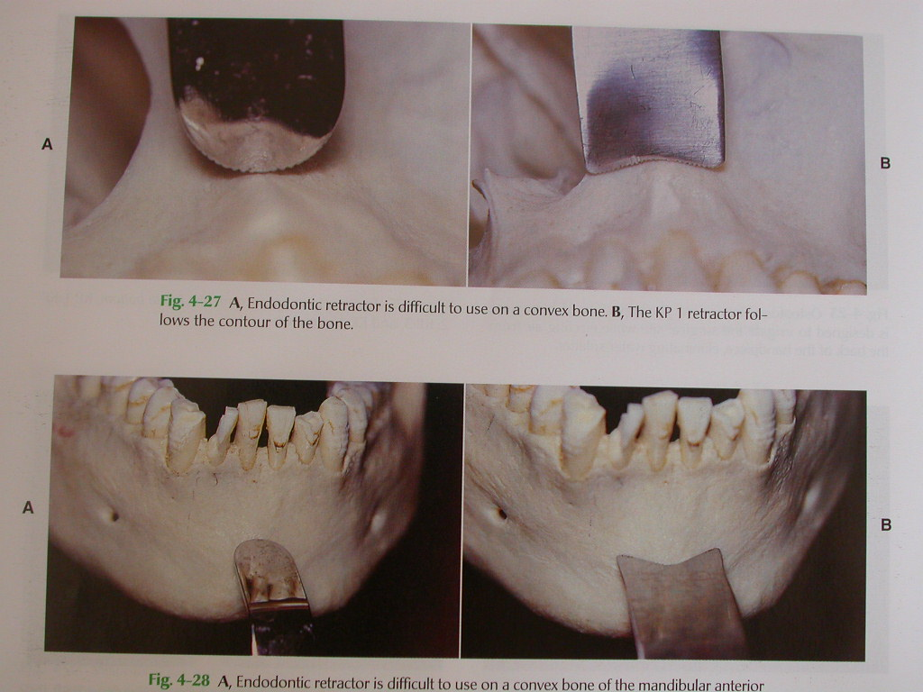
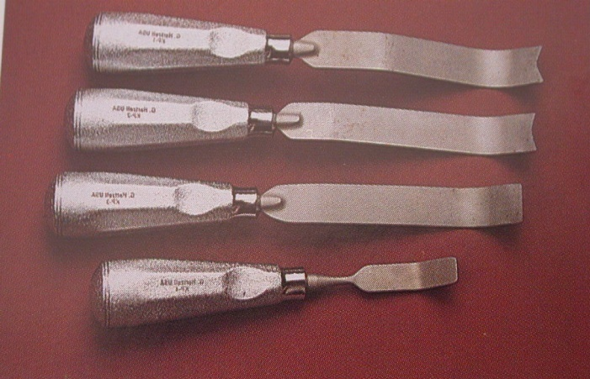
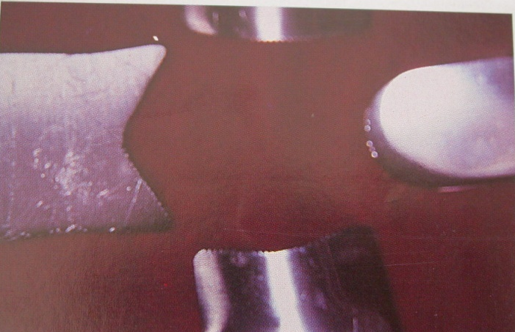
10) TISSUE RETRACTION INSTRUMENTS
Conventional
Endodontic Retractor
KP 1
KP 2
KP 3

Slide 20
LASERS IN ENDODONTICS
Gaining Importance in Recent Times.
Uses :
Procedure | Laser
Root Canal Opening | Er:YAG-Laser(2940 nm) Er:YSGG-Laser(2790 nm)
Root Canal Disinfection | Diode laser(805 nm) Nd:Yag-Laser(1064 nm)

Slide 21
INDICATIONS | LASER TYPE
Treatment of deep caries Sterlisation of root canals Vital amputation Root canal preparation | CO2, Nd:YAG LASER Nd:YAG,CO2,Ho:YAG lasers Co2Nd:YAG lasers Excimer,Nd:YAG,Er:Yag laser

Slide 22
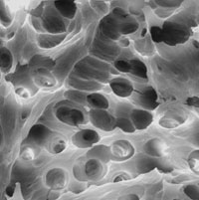
TAKE HOME MESSAGE
From a biological perspective, root canal treatment is directed toward the elimination of micro-organisms from the root canal system and the prevention of reinfection.
Technological advances in the form of rotary NiTi instruments have led to dramatic improvements in the ability to shape root canals with potentially fewer procedural complications.

Slide 23
QUESTIONS
What are various classifications of endodontic instruments?

Slide 24
REFERENCES
Endodontic Practice 11th Edn. Grossman
Pathways Of The Pulp 6th Edn. & 9th Edn. Cohen
Endodontics Vol 1 Arnaldo Castellucci
Endodontics Ingle 5th Edn.
Text book of Endodontology Bergenholtz Reitz
Endodontic Therapy Weine 5th Edition
Color atlas of Endodontics William Johnson
Principles and practice of Endodontics- Walton &Torabinejad
Color Atlas of Microsurgery in Endodontics Syngcuk Kim
Textbook of Endodontics Nisha Garg Amit Garg

Slide 25
THANKYOU

